Slide 1

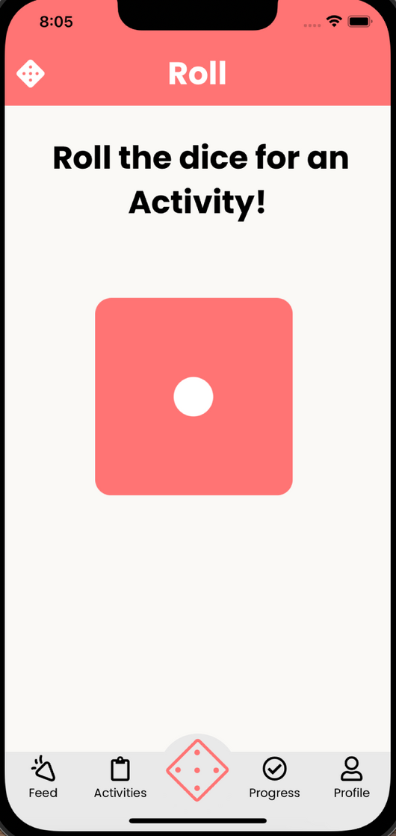


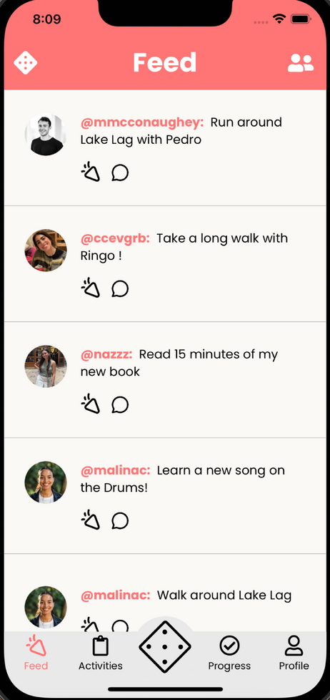
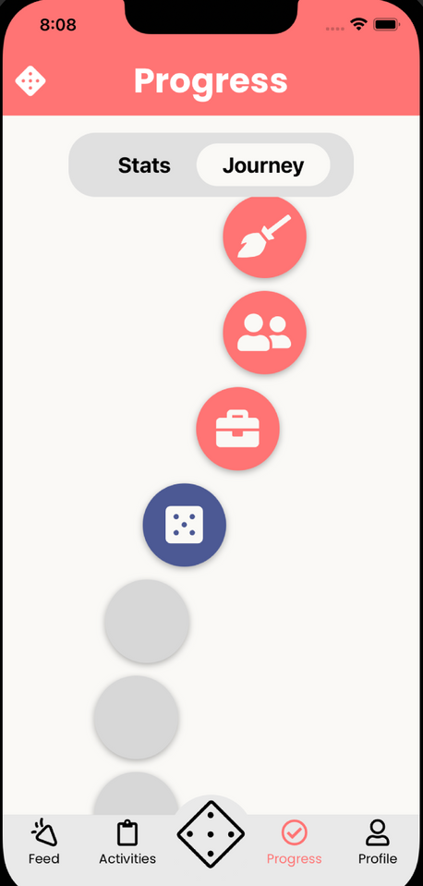
Malina, Karina, Caleb, Abbie
CS 194H Presentation 1
turno
Roll your way through the day

Slide 2

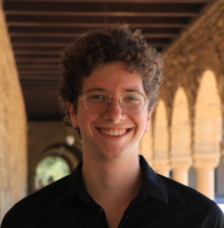
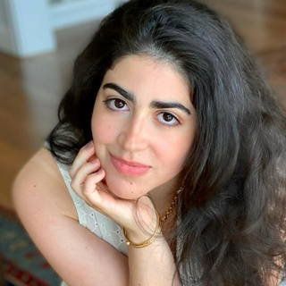
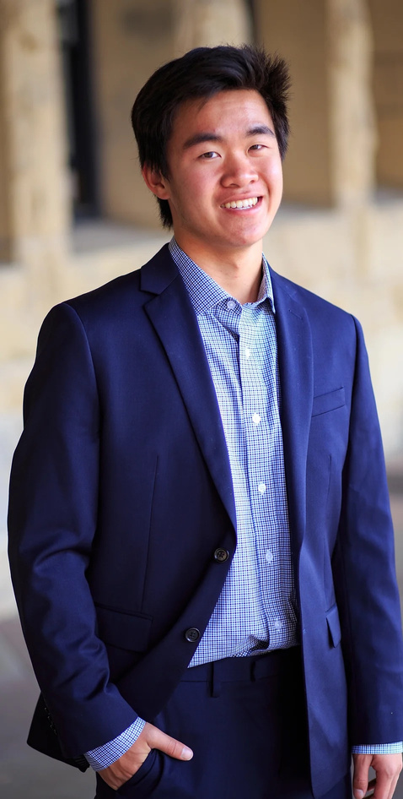



previous contributors (CS 147 Fall 2023)
turno
Presentation 1
Nazanin Soltan
Pedro Civita
Cecilia Conde
our team
Caleb Liu
Web + Mobile Developer
UI/UX Designer
Malina Calarco
Web + Mobile Developer
UI/UX Designer
Member of Fall 2023 Team
Abbie Maemoto
Web + Mobile Developer
UI/UX Designer
Karina Li
Web + Mobile Developer
UI/UX Designer

Slide 3
turno
Presentation 1
problem
Our world is saturated with choices, from what to eat to what to watch, wear, or buy. This barrage of decisions leads to endless debates, indecisiveness, and precious time lost that could be spent actually doing those tasks
solution
Turno simplifies choice-making with a digital dice where each side maps to user-input options. It’s a streamlined activity prompter that transforms the chore of choosing into a fun and quick activity, freeing up time and mental energy.

Slide 4

Design Evolution
1
Turno
Current UI Description
Agenda
2
3
Demo
4
Future Direction + Next Steps

Slide 5
Design Evolution
1
Current UI Description
2
3
Demo
4
Future Direction + Next Steps

Slide 6
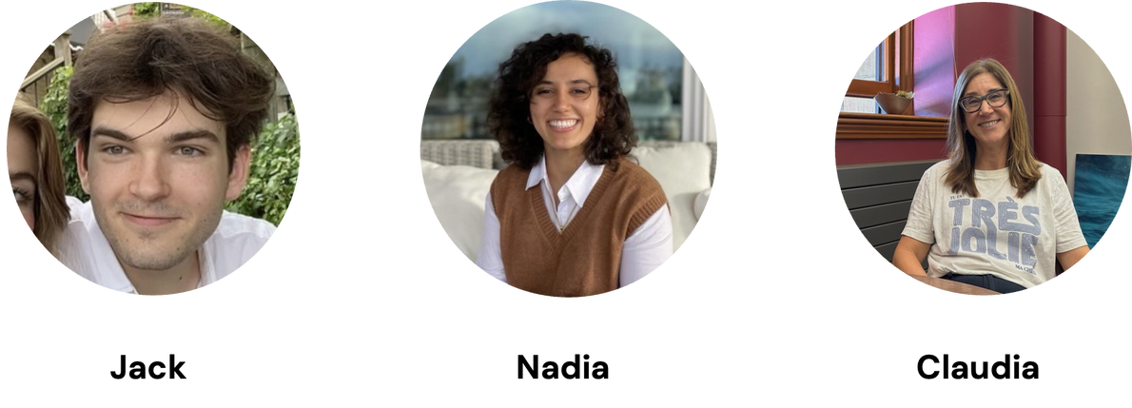

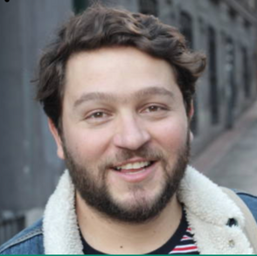
Design Evolution
Needfinding
Subjects:
Key learnings:
Habits are built over a long period of time
People’s goals and definitions of active lifestyles are very diverse
Goals need to be prioritized in order to be accomplished
It can be hard to decide what to do with your time
Jack, 21
Claudia, 55
Nadia, 21
“I got tired of apps that measured everything… I just want to move around” -Claudia
Yas, 17
Arjun, 34

Slide 7
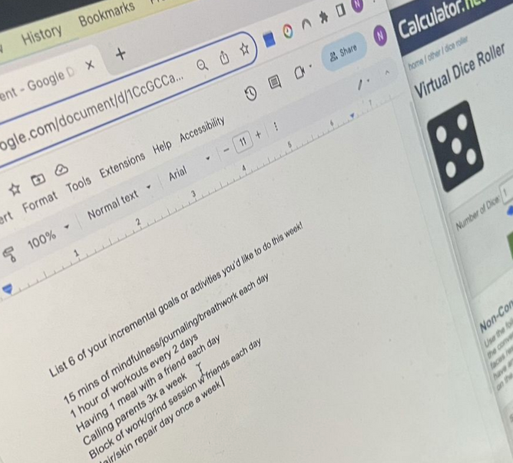
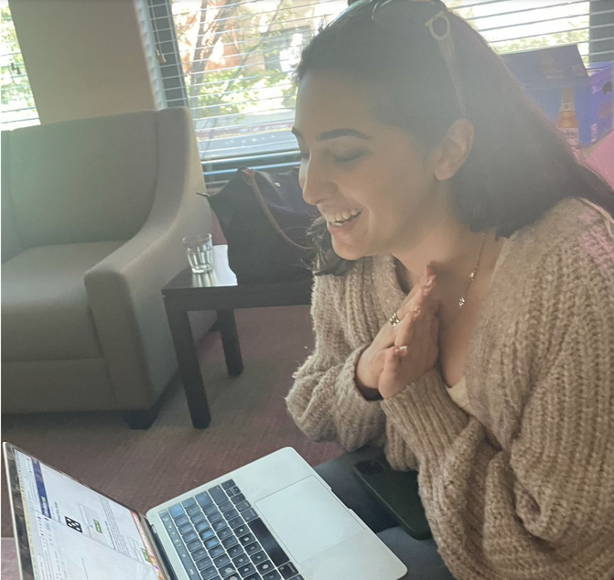
Design Evolution
Needfinding
How might we
gamify Claudia’s lighthearted, competitive spirit?
Prototype:
Roll the Dice
Assumption
The experience will be fun & motivating
Fun experience, but randomization is better for “low-stakes” activities (otherwise motivation may actually decrease with randomization)
Learnings

Slide 8
Design Evolution
Revised Solution
turno: A Randomized Activity Prompter
The name comes from the Portuguese word for shift and the idea of it being your turn to roll the die and take agency over your time

Slide 9
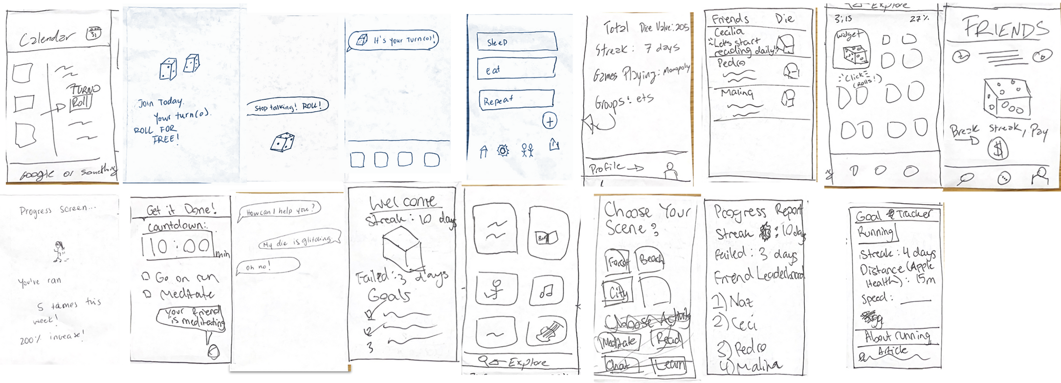
Design Evolution
Sketches

Slide 10
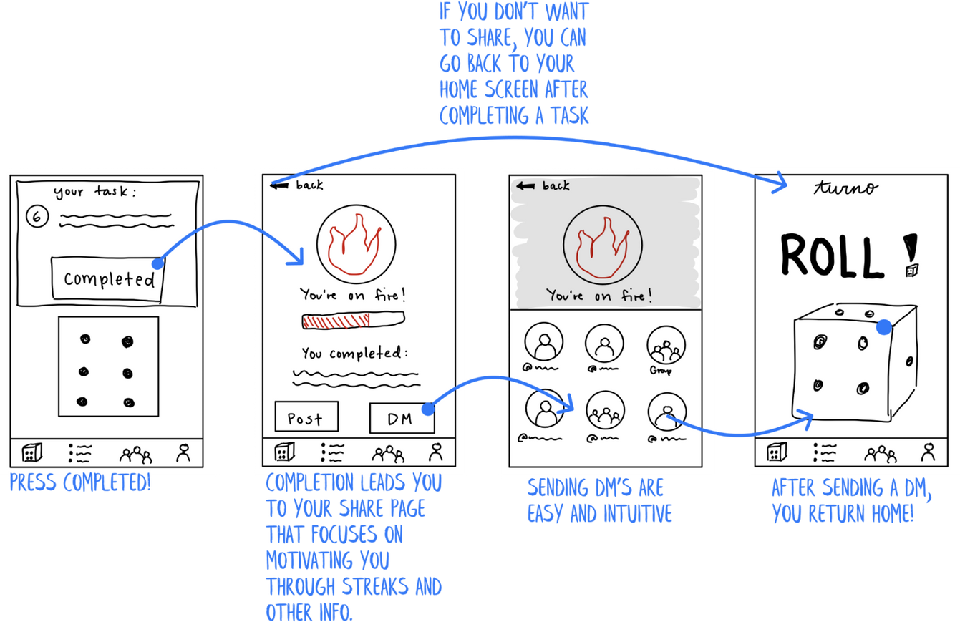

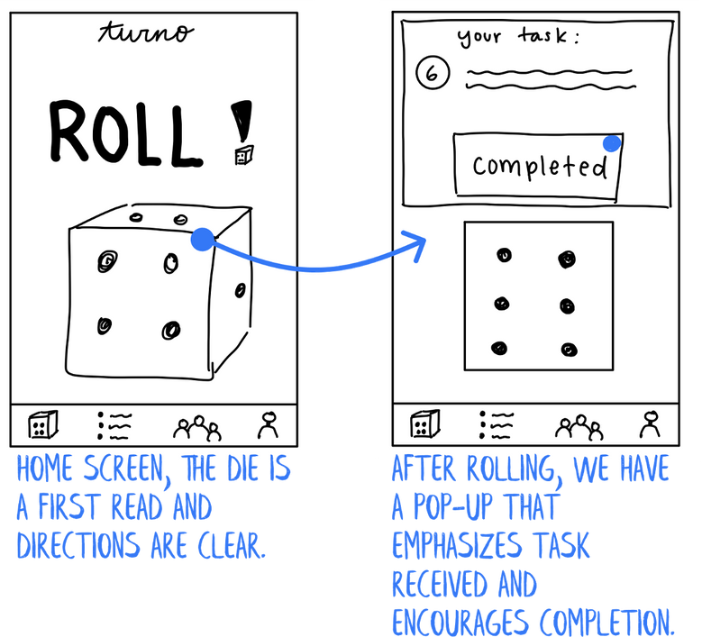
Design Evolution
Low-Fi Prototype
Complete a Task + Share the news with a friend

Slide 11

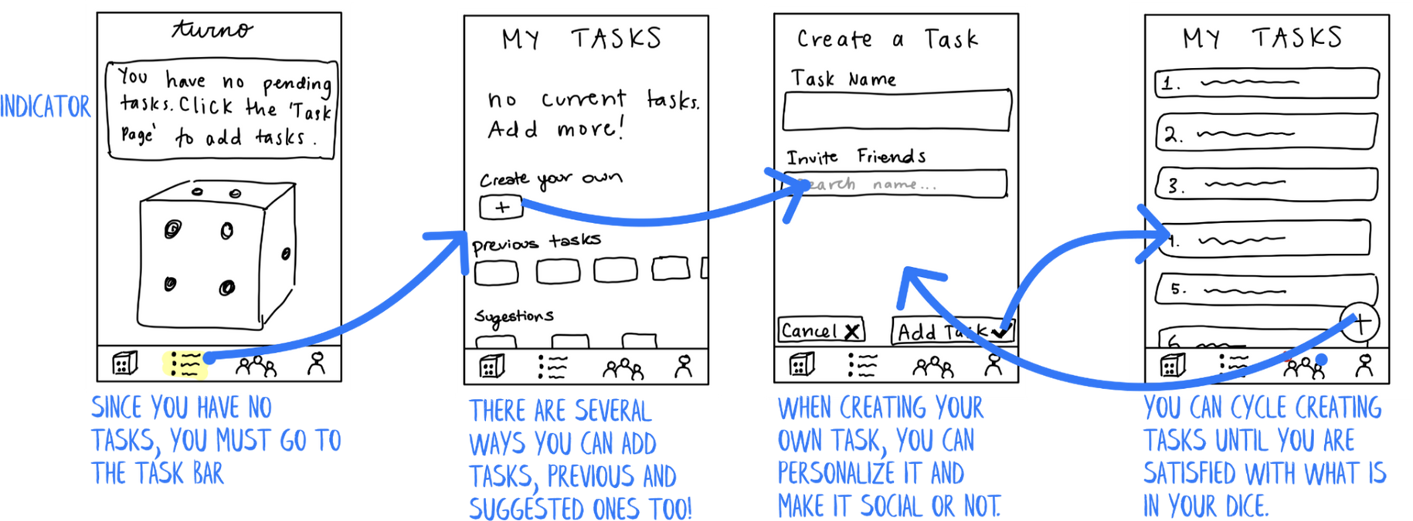
Design Evolution
Low-Fi Prototype
Write out your task list

Slide 12

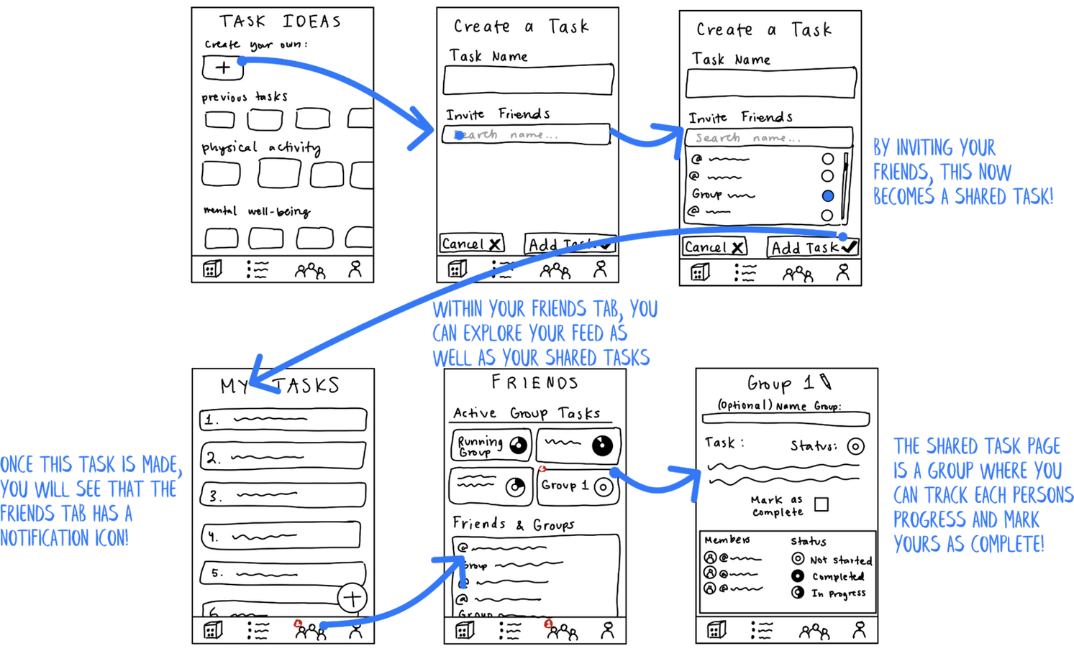
Design Evolution
Low-Fi Prototype
Complete a task with friends

Slide 13
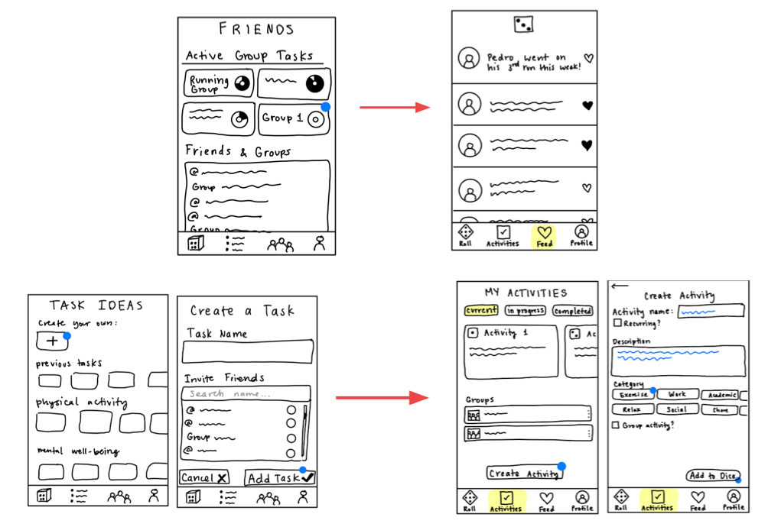
Design Evolution
Usability Test
Key Changes:
Streamlined task creation
More exit/back opportunities
Creation of feed page

Slide 14
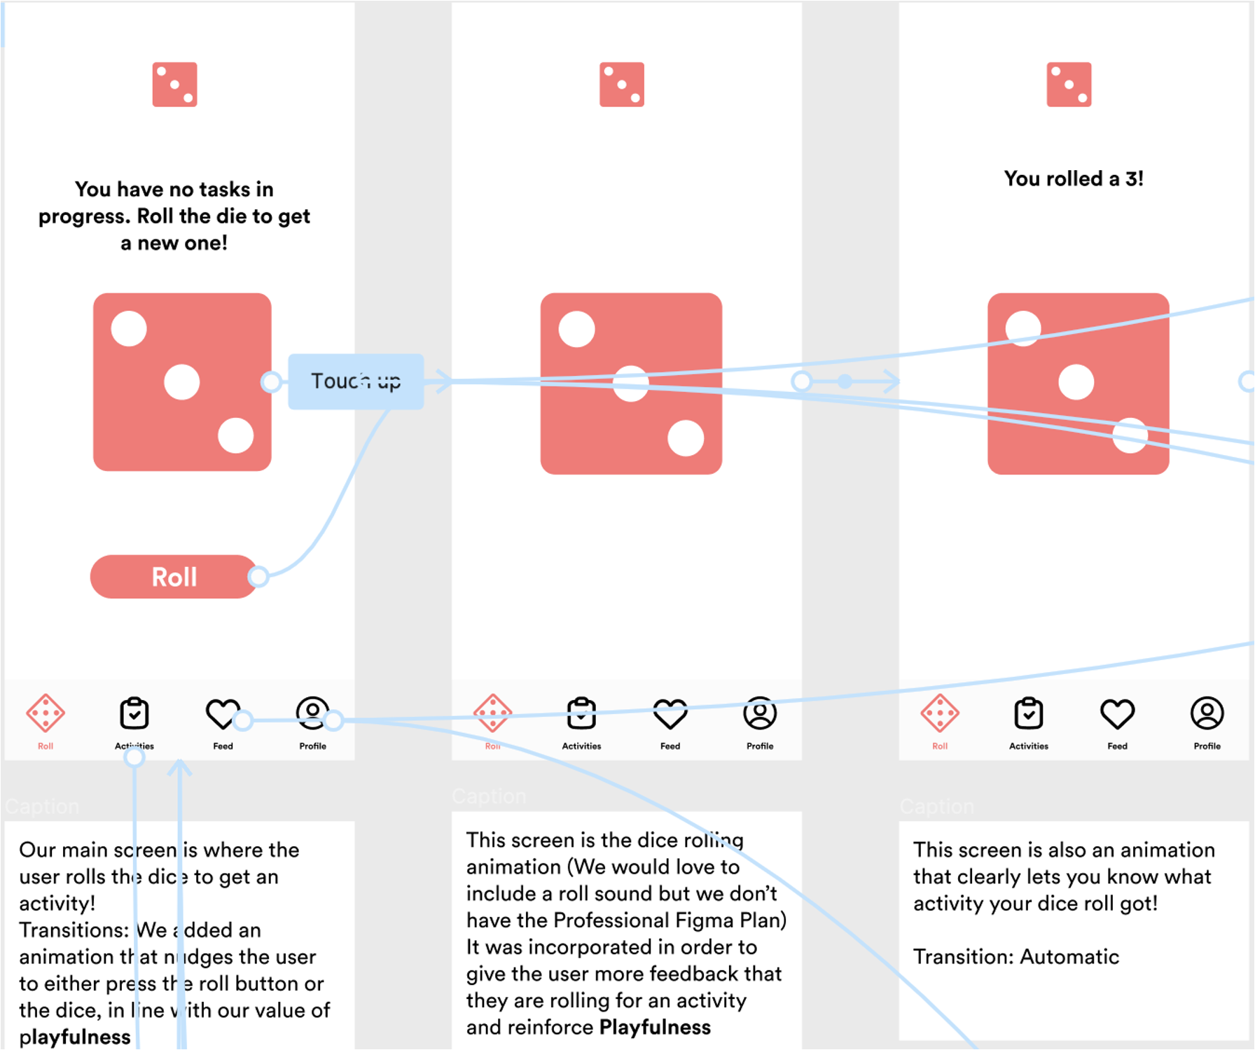
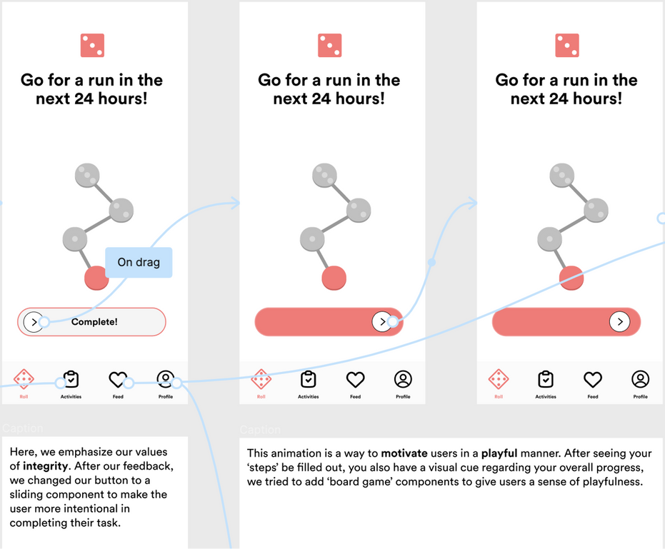
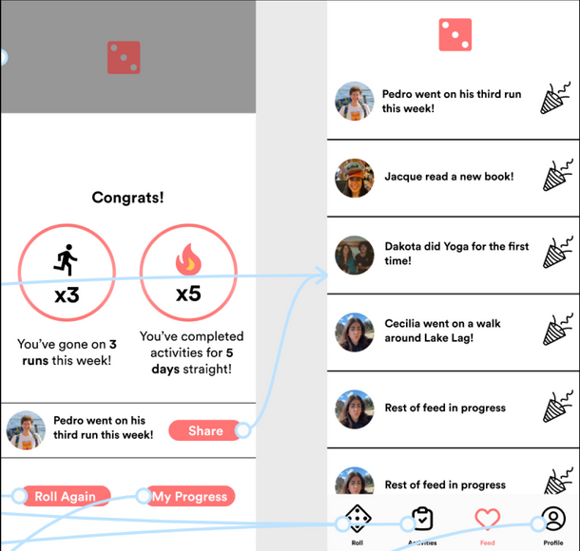
Design Evolution
Med-Fi Prototype
Complete a Task + Share the news with a friend

Slide 15
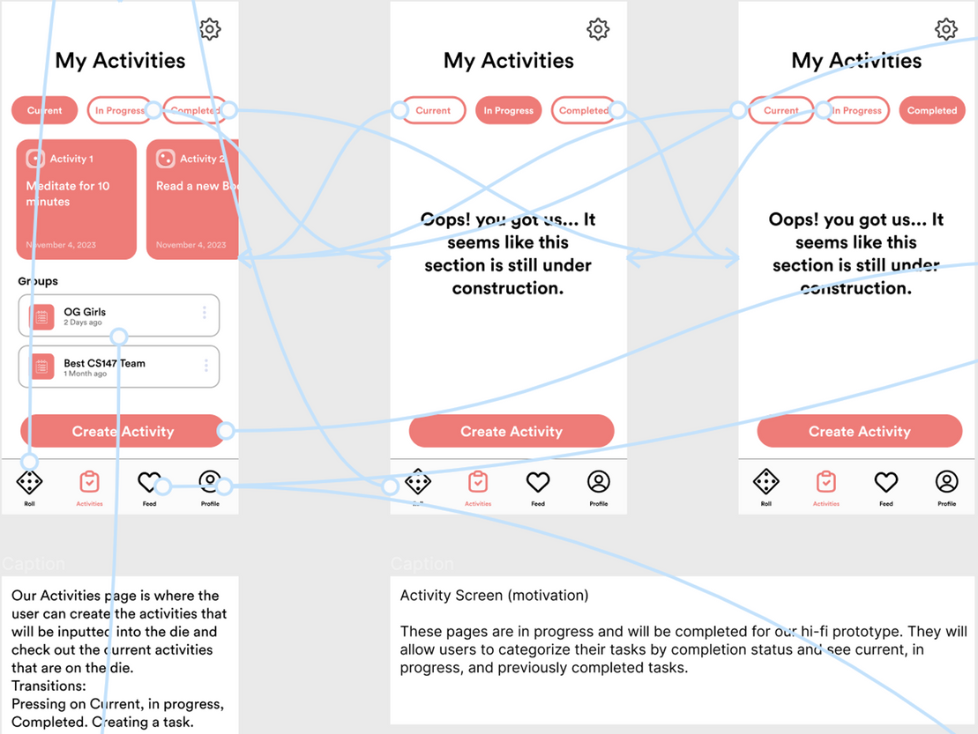
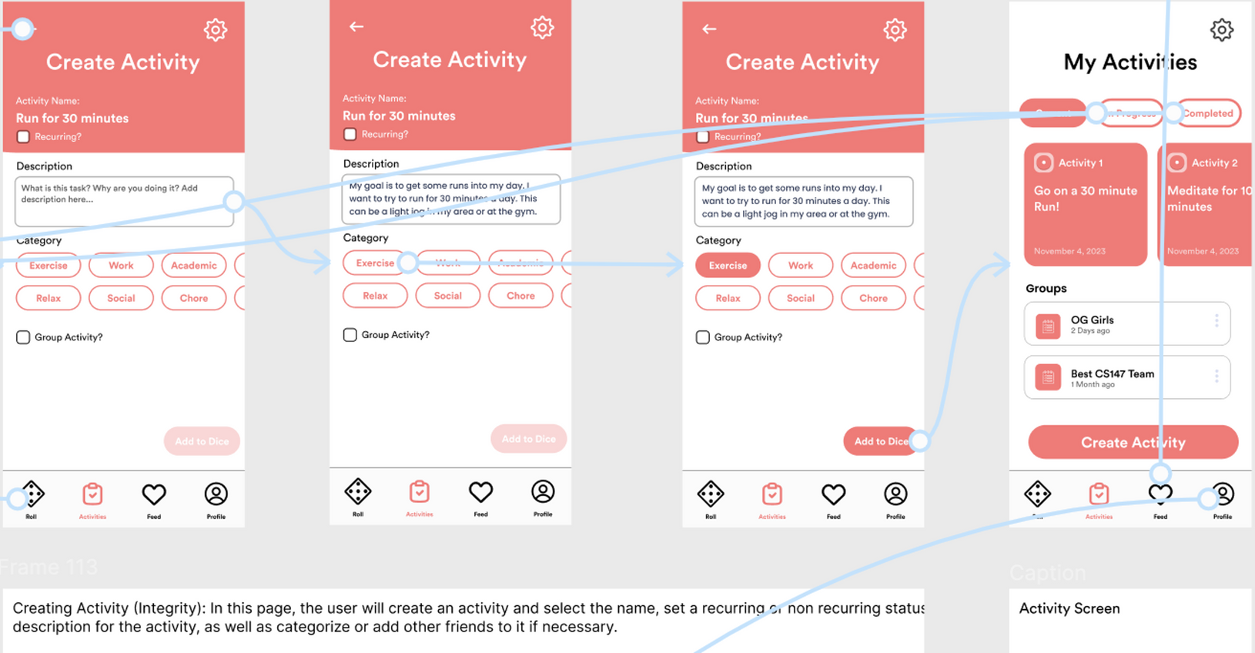
Design Evolution
Med-Fi Prototype
Write out your task list

Slide 16
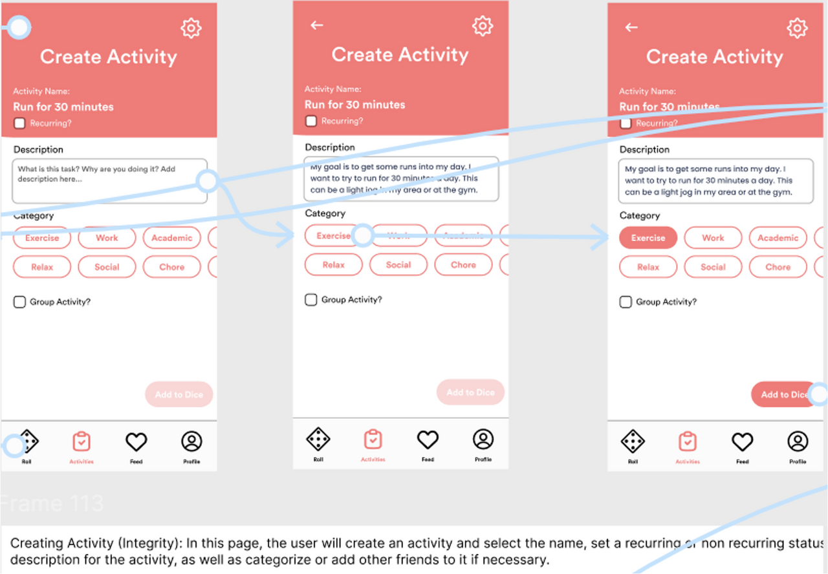
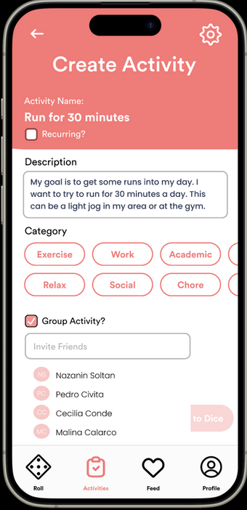
Design Evolution
Med-Fi Prototype
Complete a task with friends

Slide 17
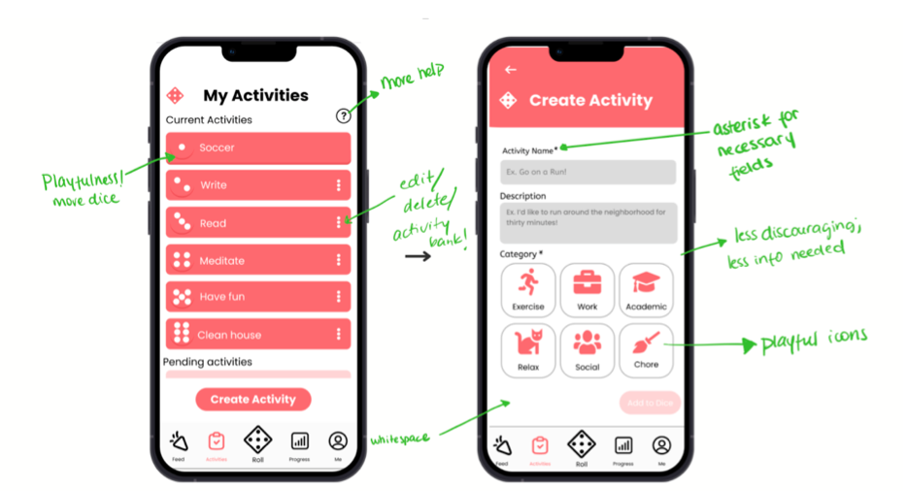
Design Evolution
Heuristic Evaluation
Key Changes:
Removing group tasks
New navigation bar
“Tasks” now called “Activities”
Gamified “Journey” page
Changed our Tasks

Slide 18
Design Evolution
1
Current UI Description
2
3
Demo
4
Future Direction + Next Steps

Slide 19
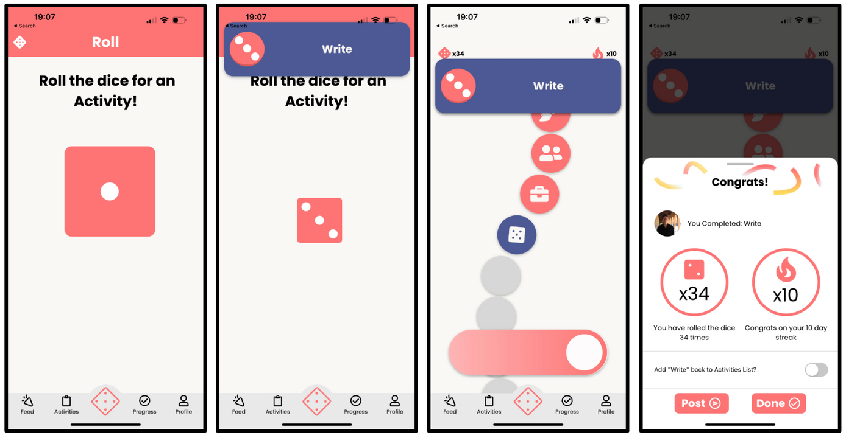
Current UI Description
High-Fi Prototype
(a) Complete an activity
Importance:
Task flow = rolling dice!
Central to the idea of overcoming decision paralysis

Slide 20
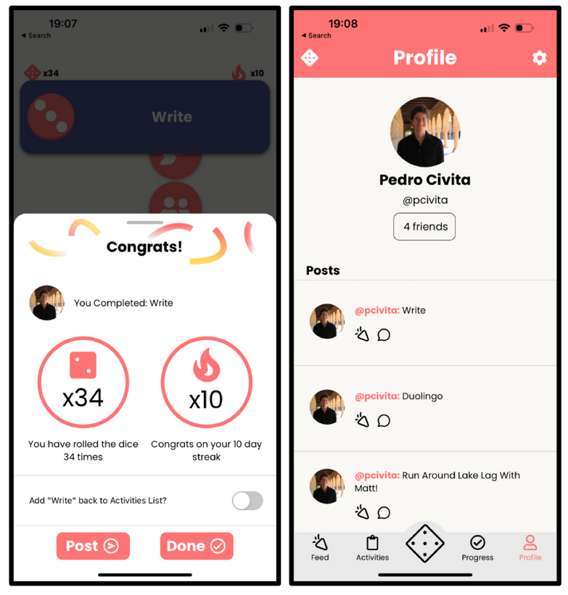
Current UI Description
High-Fi Prototype
(b) Share the news with friends
Importance:
Social, motivating, fun
Can receive positive encouragement

Slide 21
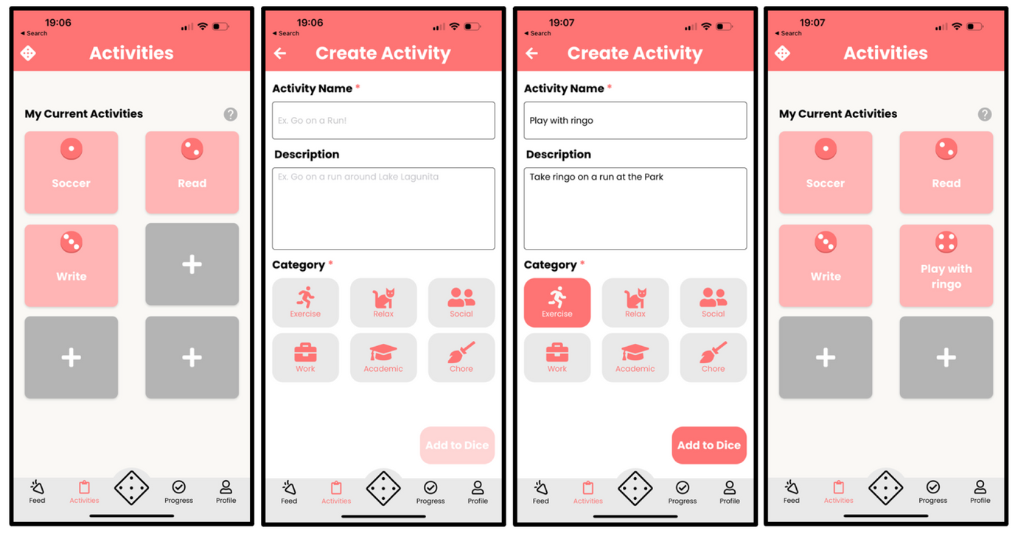
Current UI Description
High-Fi Prototype
(a) Create a new activity
Importance:
Need activities to roll dice!
User gets to decide how they use the app

Slide 22
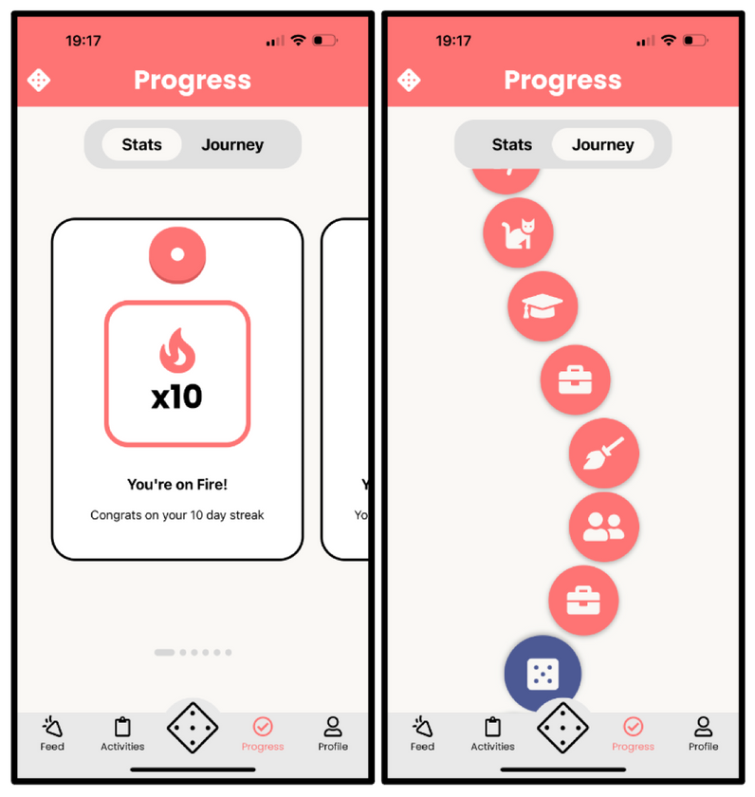
Current UI Description
High-Fi Prototype
(b) Check your activities’ progress & statistics
Importance:
Incentivizes habitual app use
Nice to have for stats-driven users

Slide 23
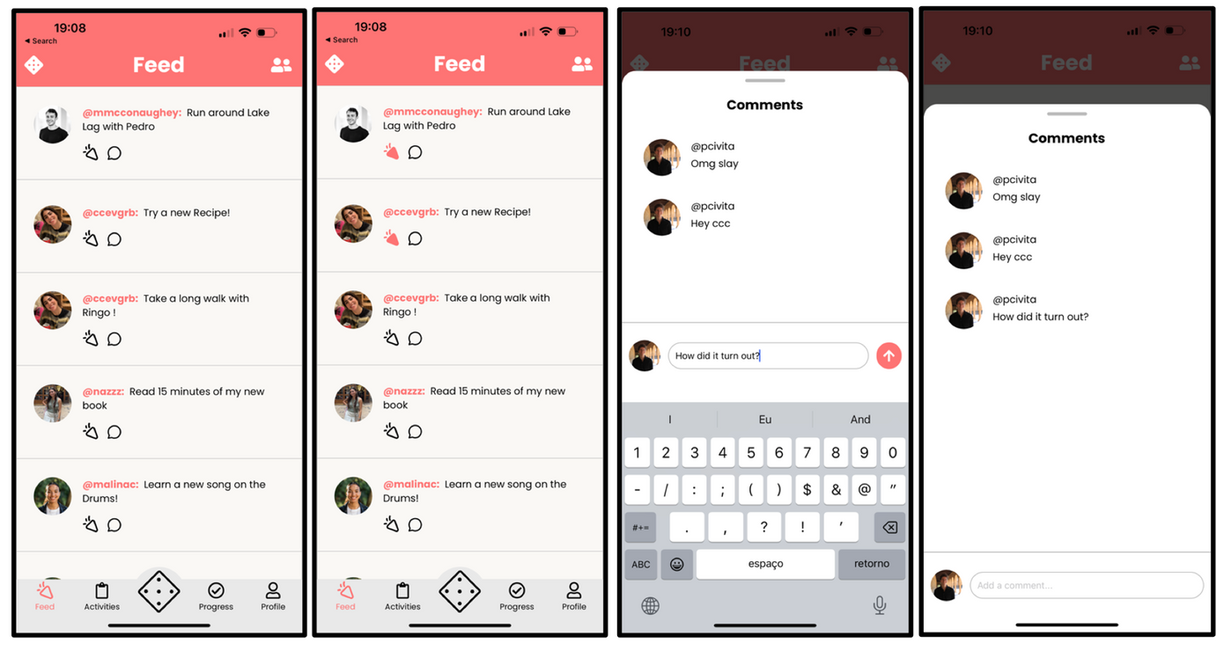
Current UI Description
High-Fi Prototype
Interact with user posts
Importance:
Social and interactive
Celebrate others’ accomplishments

Slide 24
Design Evolution
1
Current UI Description
2
3
Demo
4
Future Direction + Next Steps

Slide 25
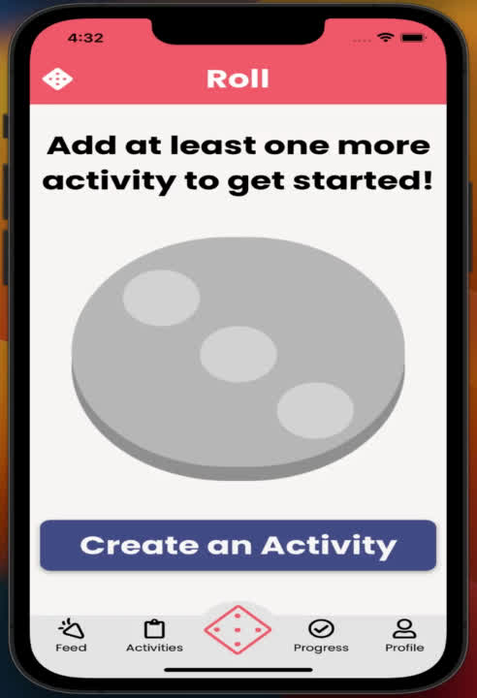
Demo

Slide 26
Design Evolution
1
Current UI Description
2
3
Demo
4
Future Direction + Next Steps

Slide 27

Future Direction + Next Steps
What’s Missing/Faked?
Journey + Stats pages are hard-coded
Incomplete, buggy backend
Animation, Sound Effects

Slide 28
Future Direction + Next Steps
Our Changes
Concept Change
Changing focus from long term habit-building to daily decisions — nature of dice rolling is that there is variance and randomness, not consistency
Emphasis on situational decision paralysis where dice can be rolled to make a quick decision
Multiple dice with custom options based on a selected theme (ex. restaurant options)
Dice can be shared and rolled by others! Acts as a recommendation engine when trying/exploring something new (ex. travel)

Slide 29
Future Direction + Next Steps
Our Changes
Features
Users can have multiple dice
Interactive map feature so users can share dice based on geographic location
Live community feed/database of dice organized by theme (ex. ability to filter dice by ‘restaurants’)
Backend Improvements
Improve Supabase backend such that images reliably & properly load
Remove hard-coded elements

Slide 30
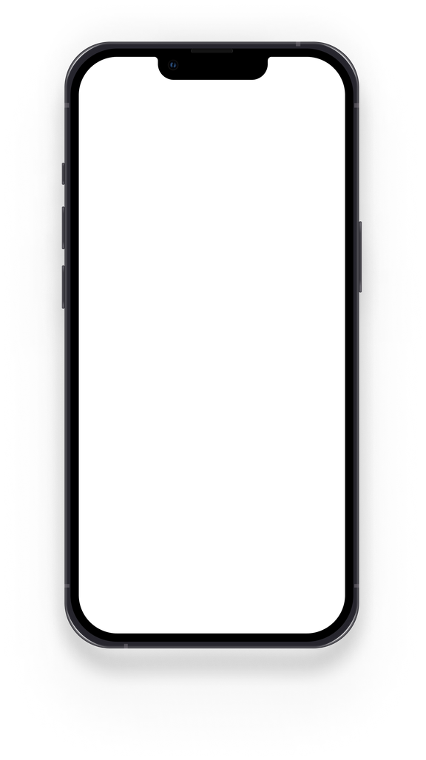
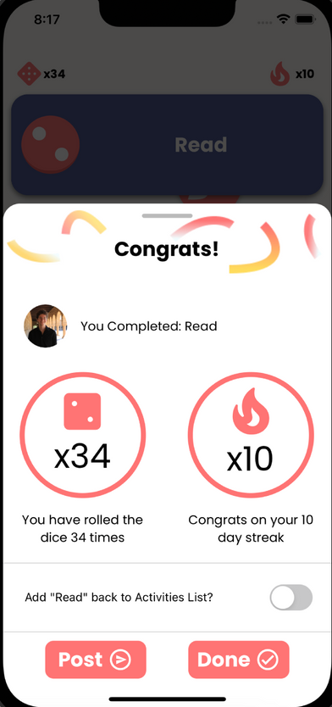
Thank you!
https://web.stanford.edu/class/cs147/projects/DesigningforActiveLifestyles/Turno/

